Slide 1


Data Analysis in Python
Natapon Pantuwong

Slide 2
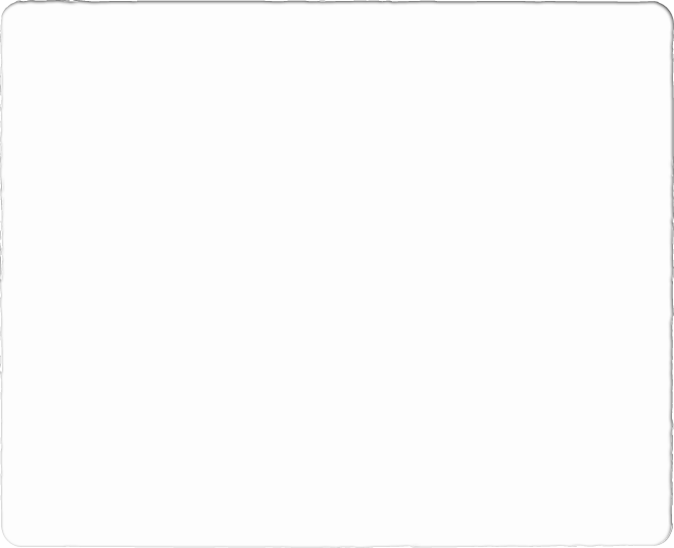

Agenda
Introduction
Understand your data
Customer segmentation
Customer Lifetime Value Prediction
Next Purchase Date Prediction

Slide 3
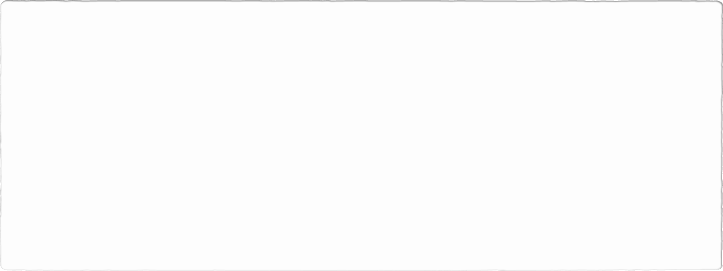
Introduction
Focus on using Python and its packages to analyze the data to improve the business in any company
Requirements
Python 3.7
Pandas : for dataframe analysis
Scikit-learn : for machine learning
Matplotlib: for visualization
Seaborn: for visualization
Plotly: for visualization
Dataset
https://www.kaggle.com/vijayuv/onlineretail

Slide 4
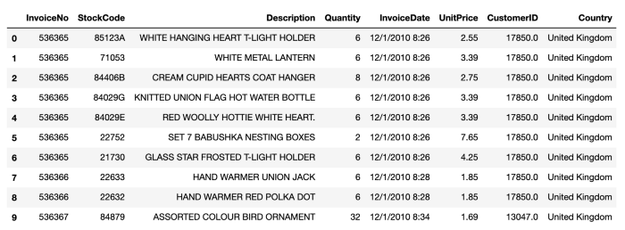
Understand Your Data (1/6)
Organization of the dataset

Slide 5

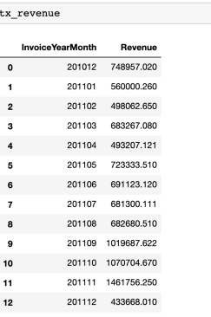
Understand Your Data (2/6)
Monthly Revenue
MonthlyRevenue = UnitPrice * Quantity
Coding to
Calculate revenue of each record
Calculate year-month of each record
Group data by year-month
Summation the revenue

Slide 6
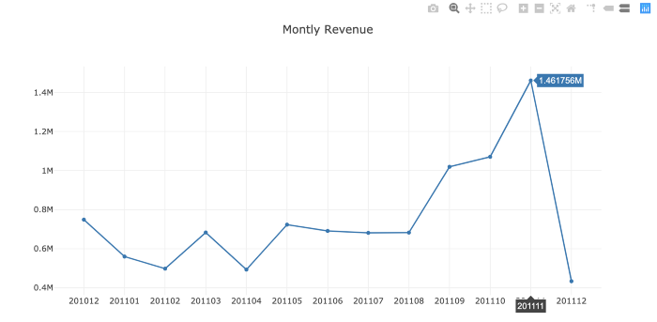
Understand Your Data (3/6)
Visualize the monthly revenue

Slide 7
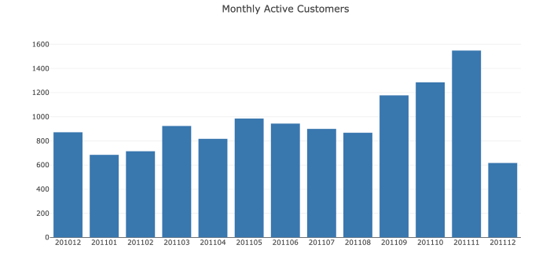
Understand Your Data (4/6)
Monthly active customer
Coding to
Group data by year-month
Get number of unique customerID in each month

Slide 8
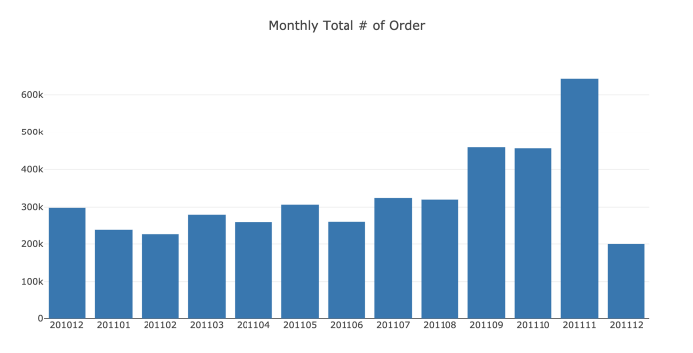
Understand Your Data (5/6)
Monthly order count
Coding to
Group data by year-month
Sum the quantity in each year-month

Slide 9
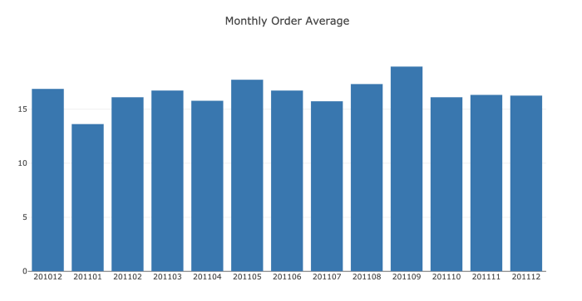
Understand Your Data (6/6)
Average revenue per order
Coding to
Group data by year-month
Average the revenue in each year-month

Slide 10
Code Explanation

Slide 11
Customer Segmentation (1/4)
Because you can’t treat every customer the same way with the same content, same channel, same importance.
RFM stands for Recency - Frequency - Monetary Value. Theoretically we will have segments like below:
Low Value: Customers who are less active than others, not very frequent buyer/visitor and generates very low - zero - maybe negative revenue.
Mid Value: In the middle of everything. Often using our platform (but not as much as our High Values), fairly frequent and generates moderate revenue.
High Value: The group we don’t want to lose. High Revenue, Frequency and low Inactivity.

Slide 12
Customer Segmentation (2/4)
To calculate Recency clusters
Recency explains how many days that each customer in inactive
Recency score
date difference between the last purchase date of each customer and last purchase date of the store
Coding to
Get last purchase date of each customer
Get the maximum of all last purchase date ( last purchase date of the store )
Calculate the date difference to be recency score of each customer
Apply K-mean to cluster customers into clusters based on recency score

Slide 13
Customer Segmentation (3/4)
To calculate Frequency clusters
Frequency explains how often that each customer do purchasing
Frequency score
Total number of orders for each customer
Coding to
Group data by customerID
Count the date in each customerID group
Apply K-mean clustering to get the frequency clustering

Slide 14
Customer Segmentation (4/4)
To calculate Monetary clusters
Monetary explains how much revenue gotten from each customer
Monetary (revenue) score
Revenue of each customer
Coding to
Calculate revenue for each transaction
Group data by customerID
Sum the revenue of each customerID
Apply K-mean clustering to get the monetary clustering

Slide 15
Code Explanation

Slide 16
Customer Lifetime Value Prediction (1/2)
We invest in customers to generate revenue and be profitable.
Lifetime value : Total revenue – Total cost
To segment customer by lifetime value
We will divide data into 2 groups; first 3 months and next 6 months
The first 3 months data will be used to extract all information (as input)
The next 6 months data will be used as an output data to train the prediction model
We will create clusters based on lifetime value of the next 6 months data, and train the model using the information from the first 3 months data.

Slide 17
Customer Lifetime Value Prediction (2/2)
Coding to
Divide data into 2 groups
Calculate RFM scores in the first 3 months group
Calculate LTV and clusters in the next 6 months group
Calculate LTV
Apply K-mean clustering
Use XGBoost to train the prediction model
Check if the model is useful

Slide 18
Code Explanation

Slide 19
Next Purchase Date Prediction (1/3)
One of the many opportunities it can provide is predicting the next purchase day of the customer.
What if you know if a customer is likely to make another purchase in 7 days?
We can build our strategy on top of that and come up with lots of tactical actions like:
No promotional offer to this customer since s/he will make a purchase anyways
Nudge the customer with inbound marketing if there is no purchase in the predicted time window
We need to predict customer based on some features to identify the group of people who willing to do purchasing

Slide 20
Next Purchase Date Prediction (2/3)
Steps to do
We divide data into 2 groups; the first 6 months and the next 3 months
Next-purchase-date interval is determined from the date difference from the last purchase from the first group and the first purchase from the second group
Calculate some features from the first group, and use them as the input of the prediction
Cluster the customers into group based on the next-purchase-date interval, and use the cluster information as an output of the prediction
Train the model

Slide 21
Next Purchase Date Prediction (3/3)
Coding to
Divide data into 2 group
Calculate features from the first group
RFM scores & clusters
Date difference between each purchase date and 3 previous purchase dates
Mean & standard deviation of the date difference between each purchase and the previous purchase
Create cluster for each customer based on the date difference between the last purchase day of the first 6 months data and the first purchase day of the next 3 months data
Apply XGBoost to train the model

Slide 22
Code Explanation

Slide 23
Summary
Python and its packages for data analysis has been introduced
Using retail dataset
Focusing on analysis of customer data
Steps and basic ideas of machine learning which is important to predict some information have been also described
Because of limited of time, each method might not be described much in detail
We could have a lab session later to do more in practice
Code can be found at
https://github.com/pantuwong/retail_analysis/

